Slide 1
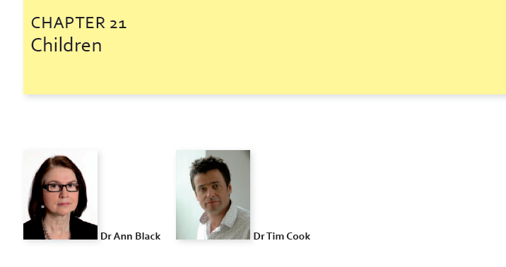

Slide 2
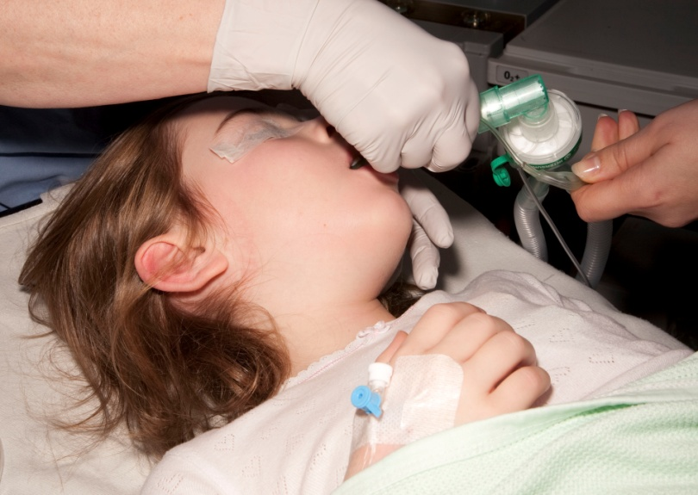
Unknowns
How many children anaesthetised in UK
Where: DGH, teaching hospital
By who?
How?
Frequency of problems?
Notes:
In NAP4 there was lots of discussion and shifting goal posts re age to be included, 0-16 decided on, older 16-21 had more adult pathology and management.
There are interesting differences in the management of adults and children which became apparent in NAP4.
It is worth questioning whether these are valid.
2

Slide 3
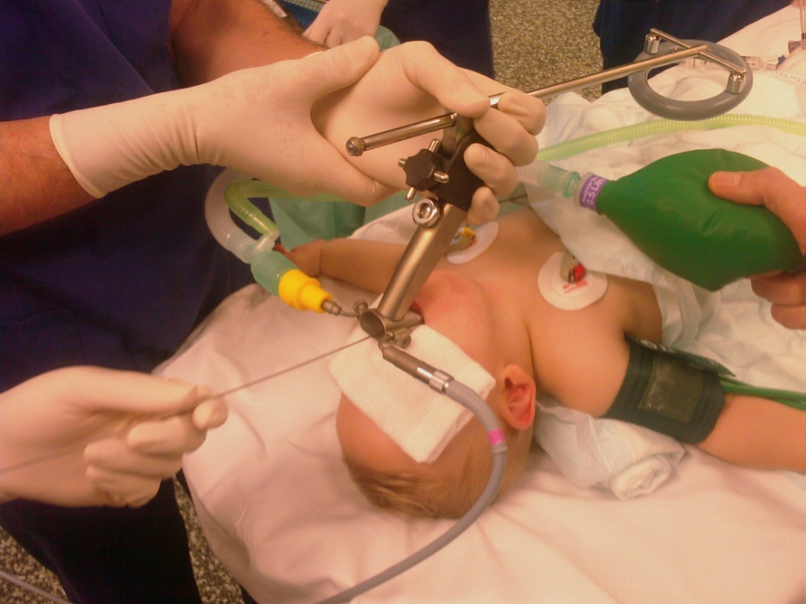
Paed airway management main differences from adults
Pre op airway assessment
SAD use (elective and advanced uses)
Surgical airway use
Management of a predicted difficulty
Usually easy, occasionally extraordinarily difficult
Notes:
In NAP4 there was lots of discussion and shifting goal posts re age to be included, 0-16 decided on, older 16-21 had more adult pathology and management.
There are interesting differences in the management of adults and children which became apparent in NAP4.
It is worth questioning whether these are valid.
3

Slide 4
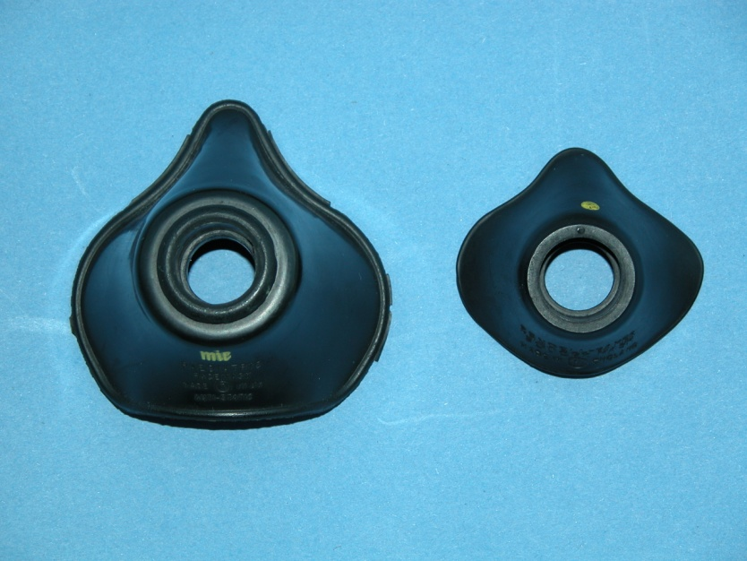
NAP4 census
Predicted diff airway
91% adult, 9% children
Adult: 89% iv/ 9% gas /10% AFOI
Child: 37% iv / 63% gas /0% AFOI
Notes:
In NAP4 there was lots of discussion and shifting goal posts re age to be included, 0-16 decided on, older 16-21 had more adult pathology and management.
There are interesting differences in the management of adults and children which became apparent in NAP4.
It is worth questioning whether these are valid.
4

Slide 5
13 paediatric cases
13 cases (8.4% of all cases)
11 cases anaesthetic (7%), 1 ICU, 1 ED
10 TT , 2 rigid bronchs,
1 LMA
Gas induction 6, iv 5
Induction 5
Maintenance 2
Emergence 2
Recoery 1

Slide 6
Primary causes of airway difficulty related to anaesthesia:
Failed intubation 2
Blocked airway 3
Airway trauma 1
Aspiration of gastric contents 1
Tube displacement 1
Problem at extubation 3
Notes:
Mostly managed with TT
Blacked airway, secretions or blood
1 FB
One LMA-patient vomited, another vomited later with TT in situ which was displaced and got into airway difficulties
Extubation: I lost TT, obstruction,

Slide 7
Summary
Outcome:
9 moderate level of harm
1 no harm
3 died (1 in each area)
Airway care:
good in 2
good and poor in 5
poor in 4
not commented on in 2.
Notes:
Views of the NAP4 panel
Deaths- one in each area-see report
Bad things can happen despite good care
Obstruction in recovery
ICU & ER patients

Slide 8
Organisational issues:
Experience of anaesthetic team: all cases involved consultants, all had appropriate assistance
Equipment / monitoring: no major issues
Organisation of services: generally to a high level
Notes:
Evidence of each in NAP4
Equally relevant to surgical teams
Lots of consultant involvement in anaesthesia care, we considered that this may mean that there is less chance for trainees to have experience or even observe these difficult events.
Equipment was satisfactory, though one child came to harm when the TT was removed from the OR and another because of delay in finding a correct tube in recovery.
Monitoring was used and generally satisfactory, but some cases ETCO2 not used / misinterpreted
Recovery standards not clear, several problems in recovery, bleeding, death. Blood in the airway in three, one died.
Task fixation was an issue and in several cases repeated attempts at intubation were tried despite no success.

Slide 9
Anaesthetic death
Young child, tonsillectomy, intubated
Arrived in recovery cyanosed
Unable to mask ventilate
Re-intubated with previous TT: unable to ventilate
Progressed to severe hypoxia, bradycardia, cardiac arrest
Re-intubated with cuffed TT after 30 mins. Clot suctioned out. Able to ventilate.
Hypoxic death.
Notes:
Views of the NAP4 panel
Deaths- one in each area-see report
Bad things can happen despite good care
Obstruction in recovery
ICU & ER patients

Slide 10
Anaesthetic death
Young child, tonsillectomy, intubated
Arrived in recovery cyanosed. Monitoring, transfer
Unable to mask ventilate. Equipment
Re-intubated with previous TT: unable to ventilate
Progressed to severe hypoxia, bradycardia, cardiac arrest
Re-intubated with cuffed TT after 30 mins. Clot suctioned out. Able to ventilate. Capnography, Equipment, Organisation
Hypoxic death.
Notes:
Views of the NAP4 panel
Deaths- one in each area-see report
Bad things can happen despite good care
Obstruction in recovery
ICU & ER patients

Slide 11
ED death
Young child, in respiratory distress
Attended by PICU senior trainee. No anaesthetist involved.
Attempts at intubation…failed..repeatedly
Capnography attached but not looked at or not interpreted correctly
Cardiac arrest and prolonged CPR.
Oesophageal intubation diagnosed as NGT passed.
Hypoxic death.
Notes:
Views of the NAP4 panel
Deaths- one in each area-see report
Bad things can happen despite good care
Obstruction in recovery
ICU & ER patients

Slide 12
ED death
Young child, in respiratory distress
Attended by PICU senior trainee. No anaesthetist involved. Organisation. Training
Attempts at intubation…failed..repeatedly. Strategy
Capnography attached but not looked at or not interpreted correctly . Training. Human factors.
Cardiac arrest and prolonged CPR.
Oesophageal intubation diagnosed as NGT passed.
Hypoxic death.
Notes:
Views of the NAP4 panel
Deaths- one in each area-see report
Bad things can happen despite good care
Obstruction in recovery
ICU & ER patients

Slide 13
ICU death
Dysmorphic neonate
Intubated at DGH with difficulty by neonatologist
Transfer to secondary centre
TT displaced during non-invasive procedure
DMV
Multiple attempts at re-intubation by three consultants
Airway rescue with LMA
Transferred to theatre for tracheostomy
LMA displaced in corridor.
Hypoxic death.
Notes:
Views of the NAP4 panel
Deaths- one in each area-see report
Bad things can happen despite good care
Obstruction in recovery
ICU & ER patients

Slide 14
ICU death
Dysmorphic neonate
Intubated at DGH with difficulty by neonatologist
Transfer to secondary centre. Transfer
TT displaced during non-invasive procedure
DMV
Multiple attempts at re-intubation by three consultants. Human Factors
Airway rescue with LMA Equipment, strategy
Transferred to theatre for tracheostomy
LMA displaced in corridor. Transfer
Hypoxic death.
Notes:
Views of the NAP4 panel
Deaths- one in each area-see report
Bad things can happen despite good care
Obstruction in recovery
ICU & ER patients

Slide 15
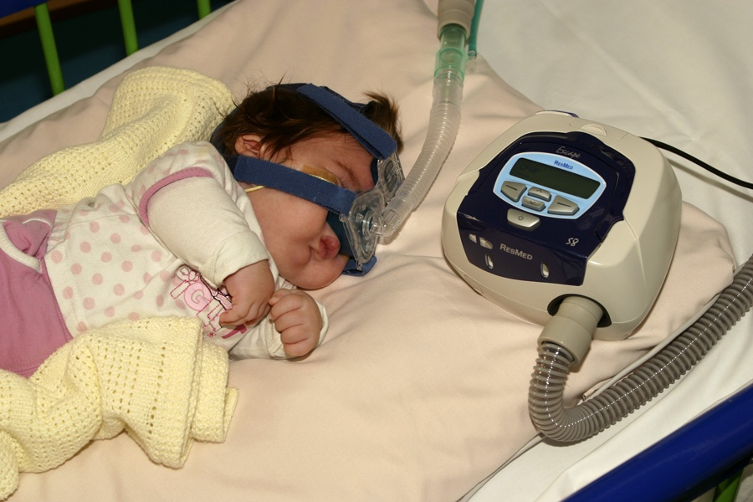
Should pre-operative airway assessment be routine?
3/11 had an airway assessment-
72% of children had no assessment
25% of adults had no assessment
Notes:
Airway assessments brief. Tests are not validated for paediatric patients.
Two patients had anticipated airway problems noted, neither were the ones that had difficulty.
1 child was checked and did have difficulty a child with tracheal stenosis

Slide 16
Abnormal airways: predicted difficult intubation
Tracheal stenosis
Dysmorphic baby admitted to PICU
Unpredicted difficult intubation in the apparently normal child did occur
Notes:
Predictable difficult airway usually syndromal. Very rare to have unexpected difficult airway but it does occur. Eg TS
Airway difficulty in ASA1&2 children did occur e.g. following anaesthesia for inguinal hernia
16

Slide 17
Intubation difficulty Six cases: 2 died. Direct laryngoscopy rarely an issue: 1 case in each area. Frequent approach…repeated laryngoscopy Minimal use of SAD rescue or alternate intubation strategies
Notes:
Intubation was difficult in 6. 2 died. Few cases had difficult D/L as an initial problem
Mackintosh, straight blade and occasional bougie used
Alternative laryngoscopes not used in any case.
There is little evidence based information available on airway management techniques in paediatrics.

Slide 18
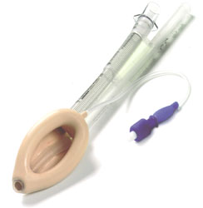
Evolving technology Use of SADs > 90% = cLMA (no census data for children only)
ProSeal and i-gel v the Classic LMA
Better fit?
Better ventilation
Less gastric insufflation
Higher airway leak pressure
Age limit?
Use in airway rescue and as conduit?
Notes:
Index cases almost all TT
Despite evidence, newer SGDs just not used. >90% cLMA , 0.1% Proseal, and 9.9% “other”
Even in snapshot alternative SGAs rarely used. Some may feel paediatric anaes should “move with the times” ?

Slide 19
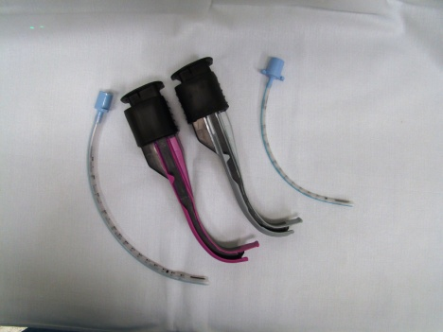
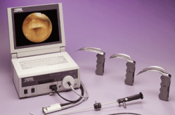
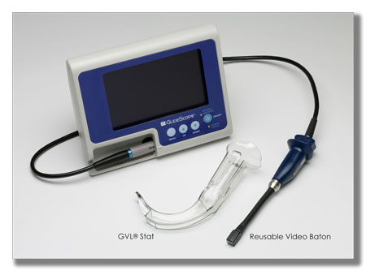
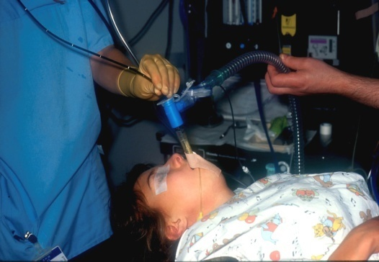
Evolving technology
Role of paediatric
videolaryngoscopes and other adjuncts
Notes:
Intubation was difficult in 6. 2 died. Few cases had difficult D/L as an initial problem
Mackintosh, straight blade and occasional bougie used
Alternative laryngoscopes not used in any case.
There is little evidence based information available on airway management techniques in paediatrics.

Slide 20
Should the paediatric strategy for the difficult intubation involve fewer repeat attempts at DL?
Most cases of DI managed with repeated attempts… up to 6
Several led to CICV
Some led to ICU admission for airway trauma
DAS/APA guidelines
Notes:
Airway assessments brief. Tests are not validated for paediatric patients.
Two patients had anticipated airway problems noted, neither were the ones that had difficulty.
1 child was checked and did have difficulty a child with tracheal stenosis

Slide 21
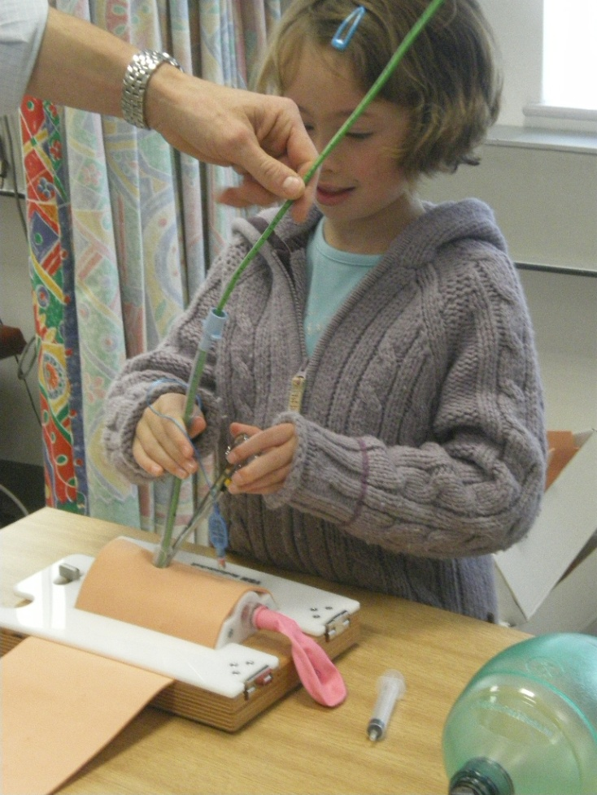
Surgical airway
NAP4 - 4 ENT surgical airways (3 successful),
- 1 anaesthetic cric (unsuccessful)
CICV rare in paediatric practice
Cricothyroidotomy difficult and risky
Jet ventilation can be difficult/risky
ENT tracheostomy used more
frequently and successfully
Notes:
Difficult,
Brackets = success
Surgical airways used in 4 patients, two had major tracheal narrowing, one a FB in the airway.
ENT, 3 successful, 1 died during transfer for a trache
Even ENT traches can be associated with significant morbidity, one case with pneumothorax and pneumomediastinum
Anaes 1 cricothyroidotomy, not successful but intubated conventionally

Slide 22
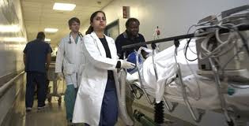
Transfers?
Transfers prominent in NAP4 paed cases
More transfers from DGH ICUs to tertiary centres
Concerns over skills at DGH end?
Transfer teams may not include anaesthetists?
Notes:
Airway assessments brief. Tests are not validated for paediatric patients.
Two patients had anticipated airway problems noted, neither were the ones that had difficulty.
1 child was checked and did have difficulty a child with tracheal stenosis

Slide 23

Bradycardia
Bradycardia in 7/13 cases
6 required CPR
Necessity for all caring
for children to understand
paediatric ALS
Notes:
Difficult,
Brackets = success
Surgical airways used in 4 patients, two had major tracheal narrowing, one a FB in the airway.
ENT, 3 successful, 1 died during transfer for a trache
Even ENT traches can be associated with significant morbidity, one case with pneumothorax and pneumomediastinum
Anaes 1 cricothyroidotomy, not successful but intubated conventionally

Slide 24
Learning points
Whilst most airway difficulties are predictable, this is not always so.
Airway assessment is infrequent in children
Monitoring at intubation is essential
Repeated attempts at DL continue to occur...time for change?
Age appropriate advanced airway equipment necessary wherever children are anaesthetised
Notes:
Keep an eye on them

Slide 25
Learning points
All those managing the paediatric airway should have appropriate ALS skills
Emergence and recovery remain times of risk
Transfers are times of risk
Senior help should be called early in difficulty.
Early involvement of ENT staff should be considered.
Notes:
Keep an eye on them

Slide 26
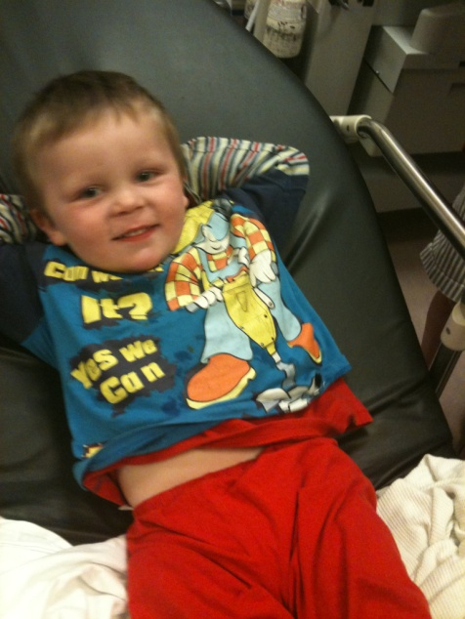
Paediatric airway management
Usually easy, occasionally extraordinarily difficult.
Not always predictable

